Slide 1
Strength of concrete
PRCP - 1019
Team Members
Kovuru Harun Rasheed
Laxman Singh
Pulugu Vamsi
Mogallapalli Manibhargav

Slide 2
Project Statement
The dataset containing the different factors that can affect the compressive strength of concrete.
The target is to use those factors to predict the compressive strength of the concrete.

Slide 3
Steps to follow
Data Cleaning
Exploratory Data Analysis
Data Pre-processing
Data Modelling

Slide 4
Data Cleaning
The raw data containing 8 variables and 1 target variable.
The name of the columns are :-
* Cement * Water * Slag * Ash * Coarse Aggregate
* Fine Aggregate * Age * Super Plastic * Strength
In the data each variable is plays crucial for the strength of the concrete.
This data don’t have any null/nan values in it.
25 Duplicates are removed in the data.

Slide 5
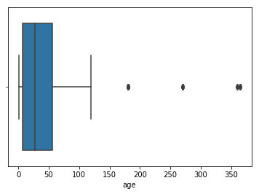
Outliers Treatment
In the “age” column detects the outliers using box plot
as shown beside.
By using IQR method, imputed the upper fence value
the place of outliers.
Note :- At the end of the step “Data Cleaning” work is completed

Slide 6
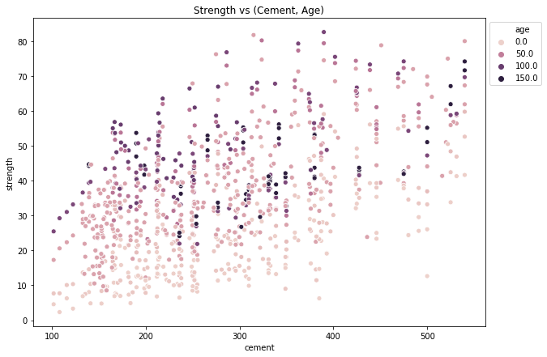
Exploratory Data Analysis
The quantity of cement increases then the strength of the concrete increases.
Strength of the concrete increases with the age.

Slide 7
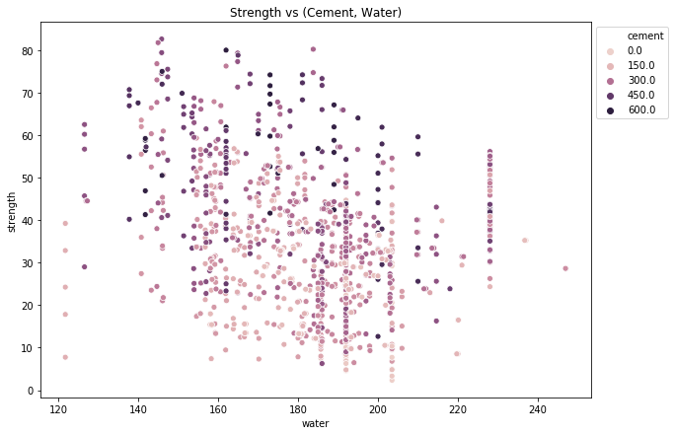
Exploratory Data Analysis
When the water decreases strength of the concrete is decreases.
Water is the plays a crucial role in strength of concrete.

Slide 8
Data Pre-processing
In the prep-processing, we did standard scalar due to it will transform your data such that its distribution will have a mean value 0 and standard deviation of 1.
After scaling the data, dataset is splitted into X and Y for modelling.
.

Slide 9
Data Modelling
In the data modelling, we did 4 models :-
* Linear Regression
* Decision Tree Regression
* Random Forest Regression
* Gradient Boosting Regression

Slide 10
Linear Regression
Metrics of linear regression:-
S.No | Metrics | Linear Regression
0 | RMSE | 8.506108
1 | MSE | 72.353867
2 | MAE | 6.563576
3 | R2_SCORE | 0.707303

Slide 11
Decision Tree
Metrics of Decision Tree Regression
S.No | Metrics | Decision Tree Regression
0 | RMSE | 7.189785
1 | MSE | 51.693011
2 | MAE | 4.898168
3 | R2_SCORE | 0.790883

Slide 12
Random Forest
Metrics of Random Forest Regression
S.No | Metrics | Random Forest Regression
0 | RMSE | 5.618542
1 | MSE | 31.568013
2 | MAE | 4.000963
3 | R2_SCORE | 0.872296

Slide 13
Gradient Boosting
Metrics of Gradient Boosting Regression
S.No | Metrics | Gradient Boosting Regression
0 | RMSE | 4.665450
1 | MSE | 21.766421
2 | MAE | 3.423395
3 | R2_SCORE | 0.911947

Slide 14
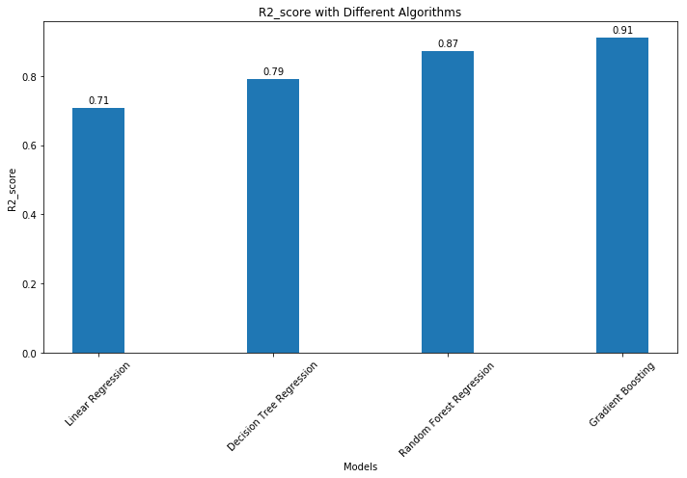
Best Model Comparison
Among the four models we seen that Gradient Boosting Regression has the good r2_score value compare to other models.

Slide 15
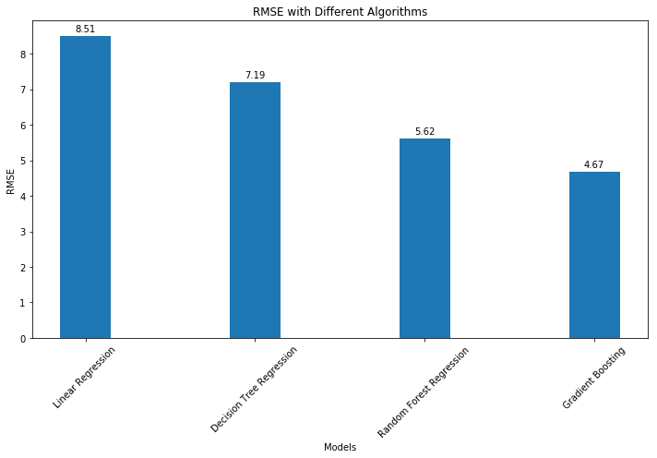
RMSE Value
Among the four models, Gradient Boosting Regression has less RMSE score.
Conclusion : At the end of the modelling Gradient Boosting is the best.

Slide 16
Thank you !!!

